Slide 1
Excel Pain Points
The Data Incubator
https://www.thedataincubator.com

Slide 2

Pain points in Excel
Higher dimensional data is awkward in 2D a spreadsheet.
Spreadsheets are great for representing 2D data. They're awkward for representing and manipulating higher dimensional data. Pivot tables only gets you so far.
Manipulating Multiple Sheets and Multiple Workbooks
Iterating over rows and columns is easy. Iterating across hundreds or thousands of sheets or workbooks is cumbersome and time-consuming.
Processing Data is Manual and Error Prone
In Excel, we often copy data or formulas around. This makes it harder to keep data accurate as new data arrives or as our computations become more complex. Errors are not always easy to catch before decisions are made.

Slide 3

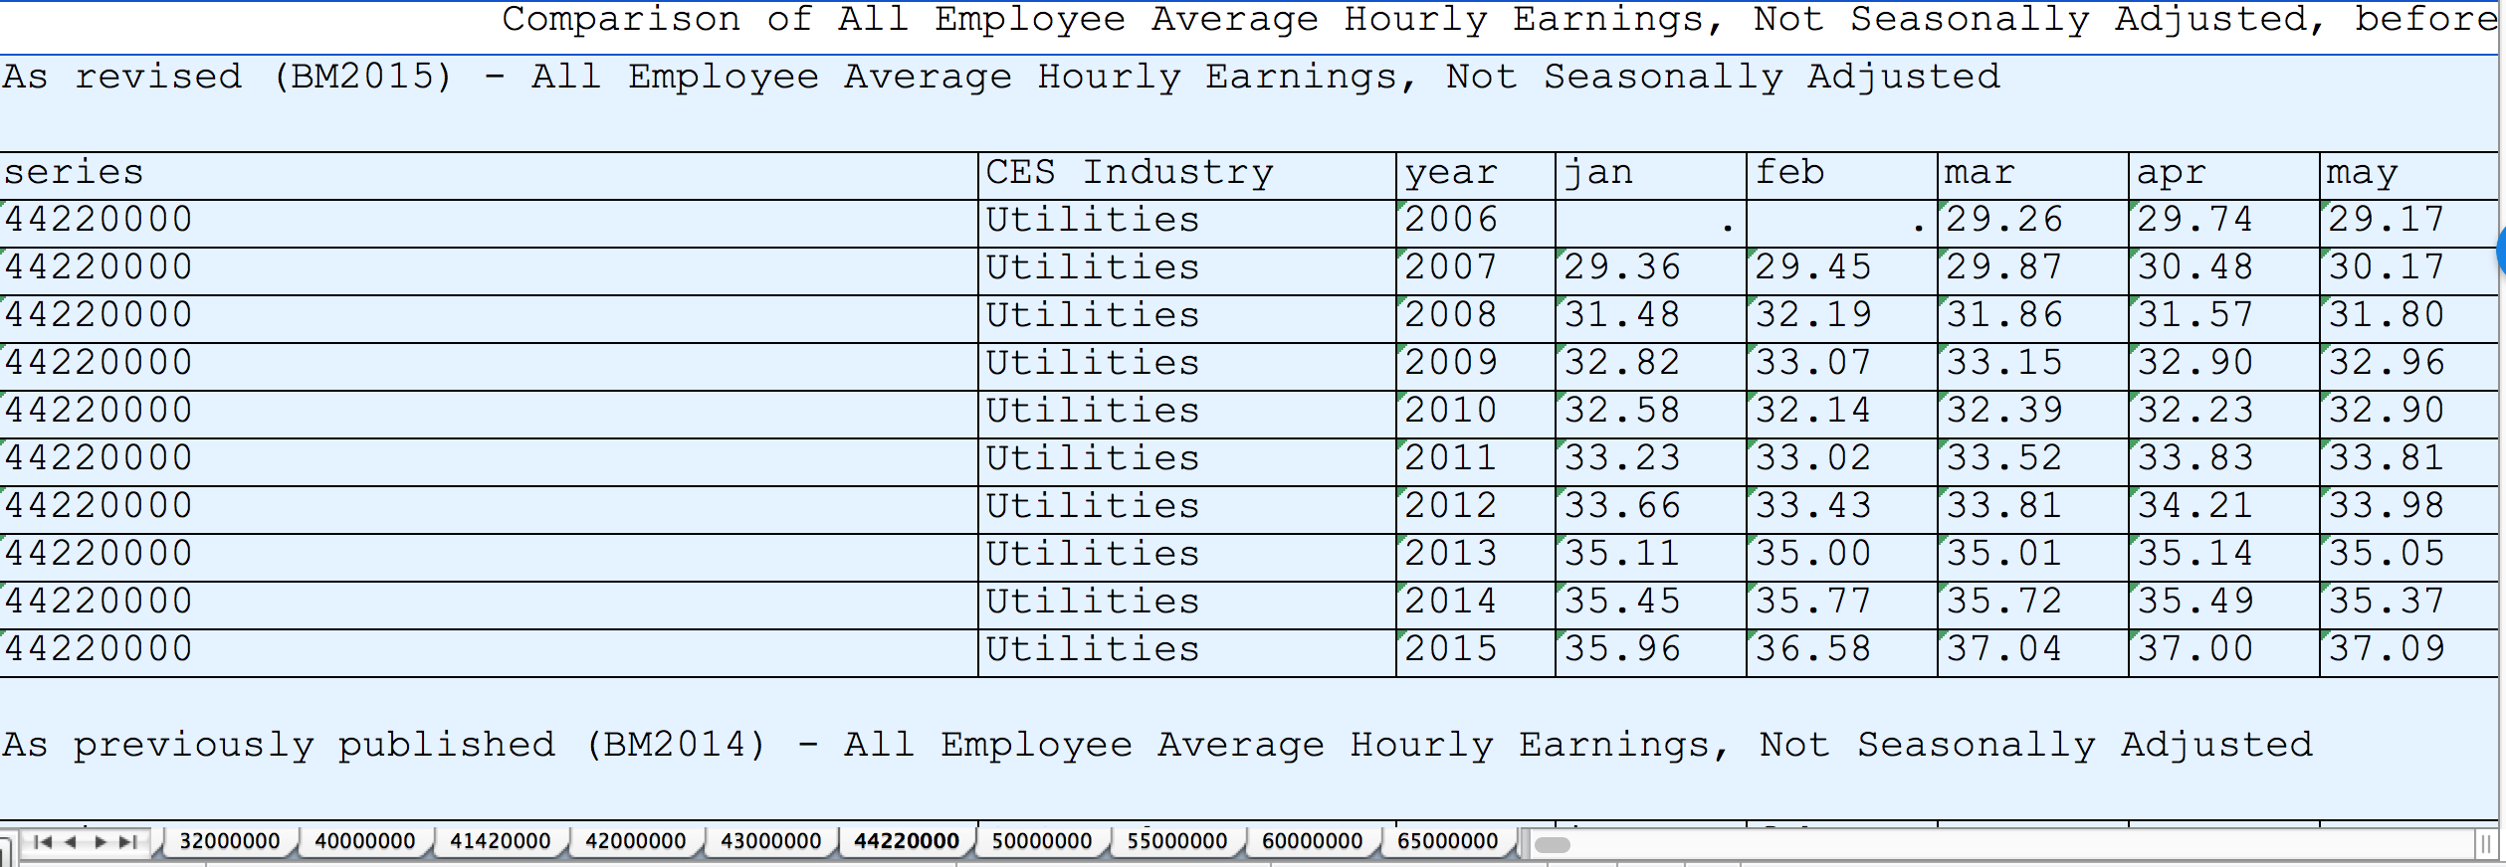

Example: BLS Data
Employment data from the Bureau of Labor Statistics:
Rows represent “years”
Columns represent “months”
Sheets represent “industry”
Workbooks represent different series (wage, hours worked, overtime)

Slide 4
Example: BLS Data
How do you produce plots of wages by industry across time based on the formula?
salary = wage * (hours + 1.5 * overtime)

Slide 5
Excel Solution
In Excel, you would:
Squash "years" (rows) and "months" (columns) into a single dimension "time".
Repeat this for every "industry" (sheets)
Repeat this for wages, hours, and overtime (workbooks).
Handle missing data ad hock:
e.g. overtime only has 3 industries while hours has all 19.
some sheets are missing data for certain dates but each sheet is different.
And then, how would you …
Repeat this analysis each month as the government updates it’s data?
Do other calculations based on the same data?

